Slide 1
Conference on Retroviruses and Opportunistic Infections (CROI) 2019
March 4 to March 7, 2019, Seattle, USA
Faculty
Pedro Cahn, Buenos-Aires, Argentina
Anton Pozniak, London, UK
François Raffi, Nantes, France
Institutional partners

Slide 2
Late pregnancy
EFV vs DTG
Late pregnancy
EFV vs RAL
ARV
strategies
LA CAB + RPV IM
ATLAS & FLAIR
2DR
3TC/DTG
GEMINI
B/F/TAF efficacy
with pre-existing
resistance

Slide 3
RAL vs EFV in pregnancy : RCT
% with Delivery VL < 200 c/ml
Overall and by Gestational Age at Entry (N = 307 women)
p = 0.001
Interaction p = 0.04
Median time to VL < 200 copies/mL:
RAL: 8 days
EFV: 15 days
5 infants born with HIV
RAL: 1
EFV: 4
All with PCR+ at birth (intra-uterine transmission)
100
94%
97%
96%
93%
90
84%
80
71%
70
60
EFV
50
RAL
40
30
20
10
90
88
89
95
0
Overall
20 to < 28W
28 to < 37W
Mirochnick M, CROI 2019, Abs. 39

Slide 4
DolPHIN-2 : RCT of dolutegravir vs efavirenz-based therapy initiated in late pregnancy Background
In South Africa, a fifth of HIV+ pregnant women initiate ART late, in 3rd trimester
Late initiation :7-fold increased risk of MTCT, + 2-fold infant mortality in 1st year
Hypothesis: Faster VL declines with DTG may reduce MTCT at birth & during breastfeeding in HIV+ mothers initiating ART in 3rd trimester
Study design
Delivery
Inclusions : Women ≥18 years , HIV+, and pregnancy test positive ≥ 28w
Uganda = South Africa
2w
6w
12w
24w
48w
72w
N = 123
EFV + 2 NRTI
Exclusions : prior ART > 1 year, prior INSTI, prior NNRTI failure, abnormal lab measures, d-d-I with EFV or DTG
DTG + 2 NRTI
N = 126
Kintu K, CROI 2019, Abs. 40

Slide 5
DoIPHIN-2 Primary Endpoint: VL < 50 copies/mL (ITT)
Time to VL < 50 c/mL (primary endpoint)
Time to VL < 1000 c/mL
1,0
1,0
92.6%
DTG
DTG
EFV
EFV
0,8
73.8%
0,8
82.6%
0,6
0,6
0,4
42.6%
0,4
0,2
0,2
RR 1.66 (95%CI 1.32 – 2.08; P<0.0001)
RR 1.11 (95%CI 1.00 – 1.23; P=0.05)
0
0
0
15
30
45
60
75
0
15
30
45
60
75
Days since randomisation
Days since randomisation
Median (IQR) time on ART at delivery: (DTG 52 [30 – 74] days vs EFV 59 [38 – 82]) days

Slide 6
DoIPHIN-2
Infant Transmissions
Safety Mothers and Infants
3 infant transmissions – all in the DTG arm
Mothers | DTG N = 137 | EFV N = 131
≥ 1 drug-related SAE | 1.5 % | 3.8 %
≥ 1 IRIS-related SAE | 0.7 % | 1.5 %
Sillbirths * | N = 4 (2.9%) | 0
Infants | DTG N = 123 | EFV N = 119
Deaths | N = 5 (4.1%) | N= 3 (2.5%)
Congenital, familial and genetic ** | 38.2% | 37.8%
 | 1 | 2 | 3
Enrolment (gestation week) | 32 | 32 | 30
Duration of ART predelivery (days) | 35 | 32 | 24
VL (c/mL) at baseline D+7 D+28 Delivery | 48969 5211 503 29 | 32844 210 100 20 | 31354 258 ND 200
Delay delivery-PCR+ in infant (days) | 5 | 3 | 11
* 2 not related (maternal syphilis) ; 3 unlikely (maternal syphilis, post-dates with fetal distress, sepsis with possible TB)
** no differences in system organ class frequencies between groups
Kintu K, CROI 2019, Abs. 40

Slide 7
Gemini 1 & 2 studies : 3TC + DTG vs FTC/TDF + DTG
Kaplan-Meier of Time to Viral Target Not Detected :
Overall Participants
By baseline HIV RNA
S48
1,0
S48
0,8
Baseline HIV-1 RNA < 100 000 c/ml
1,0
0,6
0,8
0,4
0,6
0,2
DTG + 3TC
DTG + TDF/FTC
0,4
0
0,2
DTG + 3TC
0
4
8
12
16
24
36
48
60
72
DTG + TDF/FTC
0
S48
0
4
8
12
16
24
36
48
60
72
1,0
0,8
0,6
Baseline HIV-1 RNA > 100 000 c/ml
0,4
0,2
DTG + 3TC
DTG + TDF/FTC
0
0
4
8
12
16
24
36
48
60
72
Time to target not detected, weeks
Underwood M. CROI 2019, Abs 490

Slide 8
B/F/TAF efficacy in patients with archived pre-existing resistance
2 patients with archived M184V
and VF to B/F/TAF
2 randomised switch studies (1878 & 1844)
Historical plasma genotypes + baseline HIV proviral DNA genotyping
10 000
B/F/TAF
DRV/RTV + RPV
10 000
RT : M184V IN : none
1 000
IQR
1 000
HIV-1 RNA at last follow-up (median 116 weeks)
200
HIV-1 RNA (c/ml)
BIC (Ctau (ng/ml)
100
%
98
99
50
100
97
95
Preexisting substitutions RT : K70K/R, M184M/V IN : none
100
10
Pooled B/F/TAF (N = 570)
0
0
BLQ
80
No primary resistance (N = 286)
0
12
24
36
48
With primary resistance (N = 159)
Visit date (weeks)
60
Archived M184V/I (N = 44)
10 000
B/F/TAF
DRV/RTV + RPV
10 000
40
1 000
IQR
Last on-treatment HIV-1 RNA : 61 c/ml (not genotyped)
1 000
200
HIV-1 RNA (c/ml)
BIC (Ctau (ng/ml)
20
100
50
5
100
2
1
3
10
Preexisting substitutions RT : M184M/I/V IN : none
0
0
HIV-1 RNA < 50 c/ml
HIV-1 RNA > 50 c/ml
0
0
12
24
36
48
Visit date (weeks)
Andreatta K. CROI 2019, Abs 552

Slide 9
LA CAB + RPV IM as maintenance : 2 studies ATLAS and FLAIR
ATLAS (N = 616)
On 2 NRTI + PI or NNTI or INSTI > 6 months and HIV-1 RNA < 50 c/mL
Randomisation 1 :1
Continue current oral ART
weeks lead-in CAB + RPV oral, then LA CAB + RPV IM every 4 ± 1 weeks
W48 outcome : HIV RNA ≥ 50 c/ml
5 in LA arm (1.6%)
3 in oral ART (1%)
Non-inferiority demonstrated
Virologic failure with RNA > 200 c/ml
3 in LA group : emergence of RPV-R in 3 and of INSTI-R in 1 (2 subtypes A1 + 1 subtype AG)
4 in ART group : emergence of R in 3
Discontinuation for injection site pain in LA group = 4 (1%)
FLAIR (N = 629)
Treatment induction with ABC/3TC/DTG x 20 weeks
566 Randomised 1 :1
Continue current oral ART
4 weeks lead-in CAB + RPV oral, then LA CAB + RPV IM every month
W48 outcome : HIV RNA ≥ 50 c/ml
6 in LA arm (2.1%)
7 in oral ART (2.5%)
Non-inferiority demonstrated
Virologic failure with RNA > 200 c/ml
4 in LA group : emergence of RPV-R + INSTI-R in 3 (All 3 = HIV subtype A1)
4 in oral ART group : no emergence of INSTI-R
Discontinuation for injection site pain in LA group = 4 (1%)
Swindells S, Abs 139, Orkin C. Abs. 140LB

Slide 10
TDF-TAF switch
Kidney
TDF-TAF switch
Lipids
INSTI and NTD
More data
Jury still out !
ART
Toxicity
Immunosenescence
and CMV
and Inflammation
Weight gain
on INSTI
JAK inhibitor
for residual
inflammation

Slide 11
Reversibility of renal function after TDF-TAF switch ?
Estimated probabilities of recovery
of eGFR to pre-TDF values
Retrospective analysis, Icona Foundation Cohort
1726 switched F/TDF to F/TAF, maintaining the same third drug ± same booster
1009 without boost
717 with boost (EVG/c: 559, DRV/b: 158)
Median follow-up 8 months
Boosted INSTI versus unboosted regimens
1,00
0,75
Log rank p = 0,033
0,50
Unboosted
EVG/c
0,25
0
0
5
10
15
Number at risk
Months from switch
824
447
716
406
507
313
304
239
131
141
36
63
Predictors of eGFR recovery to pre-TDF values
Boosted PI versus unboosted regimens
1,00
 | aIRR (95% CI) | p
CDC Stage C | 0.83 (0.55 - 1.25) | 0.365
Age (+ 10 years) | 0.96 (0.87 -1.06) | 0.427
Years of TDF exposure (+ 1 year) | 0.90 (0.86 - 0.94) | < 0.001
Boosted vs unboosted regimen | 0.74 (0.59 - 0.92) | 0.008
0,75
Log rank p = 0,227
0,50
Unboosted
EVG/c
0,25
0
0
5
10
15
Number at risk
Months from switch
824
121
716
109
507
84
304
61
131
27
36
9
Gagliardini R. CROI 2019, Abs 693

Slide 12
TDF-TAF switch : lipids worsening
OPERA database, US, 93 170 PLWHIV
Switching from TDF to TAF was associated with less favorable lipid profiles
Lipid changes were not driven by boosting agent use : less favorable profiles after switch regardless of boosting agent use
100%
*
*
*
*
80%
60%
40%
20%
0%
 | TDF | TAF
 | CHOL
Severe | 0.7% | 1.9%
Dylipidemia | 4.4 % | 7.6%
Borderline | 19.1% | 25.6%
Normal | 75.9% | 64.9%
TDF | TAF
LDL
3.4% | 6.5%
12.1% | 16.0%
31.1% | 32.2%
53.4% | 45.4%
TDF | TAF
HDL
NA | NA
34.8% | 30.2%
48.1% | 48.2%
17.1% | 21.6%
TDF | TAF
TG
1.5% | 2.5%
19.7% | 24.5%
17.2% | 17.6%
61.6% | 55.3%
% patient in each category
* p-value for the pre-post switch comparison < 0.0001
Mallon P. CROI 2019, Abs 652

Slide 13
JAK inhibitor to decrease residual chronic inflammation
ACTG 5336: open-label RCT ; Ruxolitinib 10 mg bid x 5 weeks + ART vs ART alone
60 patients (40 RUX), median CD4 737/mm³
Fold Change in IL-6 (pg/mL)
Fold Change in sCD14 (ng/mL)
Ruxilitinib
No Sudy treatment
Ruxilitinib
No Sudy treatment
5,0
2,00
4,5
1,75
4,0
P = 0.03
3,5
1,50
FC 1.10
3,0
1,25
FC 0.97
2,5
P = 0.18
Mean (95%CI)
Mean (95%CI)
2,0
FC 1.10
1,00
1,5
FC 0.93
0,75
1,0
0,50
0,5
0
0,25
Number of Participants
37
37
36
18
18
17
number of Participants
37
37
35
18
18
17
Bsl
Wk 4/5
Wk 10/12
Bsl
Wk 4/5
Wk 10/12
Bsl
Wk 4/5
Wk 10/12
Bsl
Wk 4/5
Wk 10/12
Study Week
Study Week
Marconi VC. CROI 2019, Abs 37LB

Slide 14
Change in weight before and after switch to INSTI ACTG Cohort
Participants characteristics (N = 691)
Prospective observational cohort
ACTG A5001 and A5322, with long term follow-up post end of trial
Restriction of analysis to patients who switched for INSTI while having HIV RNA < 200 c/ml at switch
Evaluation of weight change overtime for each individuals and predicted change in weight according to age
Multivariate linear mixed effects model to evaluate weight change before and after switch to INSTI
Adjustment on age at switch, sex, ethnicity, initial BMI, nadir CD4, % time with HIV RNA < 200 c/mL, smoking, diabetes
Median age | 51
Male, % | 82
Ethnicity : black/hispanic, % | 26/19
CD4 currents/nadir, median/mm³ | 610/185
BMI (kg/m²), median | 26,9
ARV before switch to INSTI : PI / NNRTI, % | 63 / 35
NRTI at switch to INSTI : ABC/TDF/TAF, % | 25/49/14
Smoking/Diabetes, % | 57/12
Adjusted difference in annual weight gain, following switch to INSTI was significant :
for women
Blacks: + 0,9 kg/yr (p = 0.04)
Whites: +1,4 kg/yr (p = 0.02)
≥ 60 years: + 2 kg/yr (p = 0.008)
Obeses (BMI > 30) : + 1,7 kg/yr (p = 0.002)
≤ 40 years : - 2,5 kg/yr (p = 0.02)
for men ≥ 60 yr : + 0,8 kg/yr (p = 0.004)
Lake JE. CROI 2019, Abs 669

Slide 15
Change in weight before and after switch to INSTI
Change in weight pre/post switch to INSTI
Change in weight post switch to INSTI
100
95
90
DTG : +1.3 kg/year
90
80
EVG/c : +0.9 kg/year
85
RAL : +0.3 kg/year
70
Follow-up since ART initiation
-20
-14
-10
-4
-2
0
2
4
10
80
83
0
2
4
6
8
10
Years since INSTI switch
82
Follow-up 2 years before and after switch
81
PI ➔ RAL
NNRTI ➔ RAL
PI ➔ EVG/c
NNRTI ➔ EVG/c
80
PI ➔ DTG
NNRTI ➔ DTG
PI ➔ INSTI
NNRTI ➔ INSTI
79
-2
-1
0
1
2
-2
-1
0
1
2
-2
-1
-0.5
0
0.5
1
2
Lake JE . CROI 2019, Abs. 669

Slide 16
Weight gain after starting first line INSTI: NA-ACCORD Cohorts
Prospective observational study, 17 NA-ACCORD cohorts
ART naive patients starting first line of triple ART (NNRTI, PI, INSTI) between 2007 et 2016
Multivariate linear mixt effects model, adjusted for age, sex, ethnicity, baseline weight, CD4, Viral load, year of ART initiation and cohort site
Censoring if virologic failure, ART switch or lost to follow up
Participants characteristics (N = 24 001)
 | NNRTI (N = 11 825) | PI (N = 7 436) | INSTI (N = 4 740) | p
Median age, years | 43 | 42 | 39 | < 0.05
Male, % | 90 | 80 | 86 | < 0.05
Black, % | 42 | 43 | 40 | < 0.05
Year ART start, median | 2010 | 2010 | 2014 | < 0.05
BMI (kg/m²), median | 25 | 25 | 25 | < 0.05
CD4/mm³, median | 312 | 262 | 360 | < 0.05
HIV RNA, log₁₀ c/ml, median | 4.6 | 4.7 | 4.6 | < 0.05
Bourgi K. CROI 2019, Abs. 670

Slide 17
Weight gain after starting first line INSTI: NA-ACCORD Cohorts
Predicted weight changes
(5 years of ART initiation)
Predicted weight changes
(2 years of INSTI initiation)
86
86
+6.0
+6.0
INSTI
DTG
+4.9
+4.9
84
+5.1
84
RAL
PI
PI
+4.4
+4.3
+3.8
NNRTI
EVG
NNRTI
82
+3.3
82
ART class/INSTI group
ART group
NNRTI-based
INSTI-based
PI-based
80
NNRTI-based
80
RAL
PI-based
DTG
EVG
0
1
2
3
4
5
0.0
0.5
1.0
1.5
2.0
Years since ART initiation
Years since ART initiation
Bourgi K. CROI 2019, Abs. 670

Slide 18
Weight gain on ARV : risk factors (US Cohort)
Retrospective study, 4 US regions
Of 20 953 patients on ARV, selection of 6 721 who switch for a new regimen between Aug 2013 and Aug 2017, with undetectable viral load at switch and during follow up ; 3 468/6 721 had BMI measure at Day 0 (switch) and during follow up
Population characteristics (N = 3 468)
Mean age | 47,5
Male, % | 81
Ethnicity : black/ white, % | 28 / 61
CD4/mm³, mean | 657
BMI (kg/m²) : < 18.5 / > 30, % | 1 / 39
ARV : INSTI / NNRTI / PI, % | 64 / 28 / 20
Comorbidities, % CKD CVD Diabetes Hyperlipidemia Hypogonadism Psychiatric disorders | 9 12 8 36 19 16
McComsey GA. CROI 2019, Abs. 671

Slide 19
Weight gain on ARV : risk factors (US Cohort)
Multivariate analysis of weight gain > 3%
Underweight at baseline
1.77 [0.9, 3.4], 0.091
Psychiatric Disorder
1.28 [1.0. 1.61. 0.020
Female
1.25 [1.0, 1.6], 0.055
Age < 30
1.16 [0.9, 1.6], 0.346
Hypertension
1.15 [0.9, 1.4], 0.148
Hyperlipidemia
0.96 [0.8, 1.2], 0.682
INSTI use
0.95 [0.7, 1.3], 0.740
CVD
0.88 [0.7, 1.1], 0.315
Diabetes
0.85 [0.6, 1.2], 0.310
Age 50+
0.84 [0.7, 1.0], 0.051
CKD
0.81 [0.6, 1.1], 0.168
Hypogonadism
0.81 [0.6. 1.0]. 0.050
NNRTI use
0.79 [0.6, 1.1], 0.125
Overweight at baseline
0.69 [0.6, 0.8], <0.001
Obese at baseline
0.62 [0.5, 0.8], <0.001
PI use
0.58 [0.4, 0.7], <0.001
0,00
1,00
2,00
3,00
4,00
McComsey GA. CROI 2019, Abs. 671

Slide 20
Weight gain after switch to INSTI in virologically suppressed patient : HIV Outpatient study
Retrospective analysis
653 patients with HIV RNA suppressed > 1 year, switching to new regimen with or without INSTI between 2007 and 2017
> 2 measures of BMI before switch and > 1 after switch
Censoring if second switch, switch off INSTI
Multivariate linear model
Switch for INSTI = 368 for non-INSTI = 285
Comparison | p value
RAL vs Non-INSTI | 0,004
DTG vs Non-INSTI | 0,002
EVG vs Non-INSTI | 0,23
RAL vs DTG | 0,03
RAL vs EVG | 0,04
DTG vs EVG | 0,003
DTG
28
RAL
27
Body Mass Index
Non INSTI
26
EVG/c
25
24
-200
-100
0
100
Months from switch (0 is time of switch)
Palellla FJ. CROI 2019, Abs. 674

Slide 21
BMI changes after PI or INSTI ART initiation
Yearly BMI changes
0,5
Monocentric study (Dallas), 2009-2017
Comparison of early change in BMI following PI or INSTI initiation according to
gender
ethnicity
0,4
Men
Women
0,3
0,2
0,1
0
ATV
DRV
LPV
RAL
EVG
DTG
0,6
Blacks
0,5
Hispanics
Whites
0,4
0,3
0,2
0,1
0
ATV
DRV
LPV
RAL
EVG
DTG
-0,1
Bedimo R. CROI 2019, Abs. 675

Slide 22
No weight gain in HIV negative individuals on CAB LA
Phase 2a, 199 uninfected individuals, randomised, placebo-controlled
2 dose/dose-interval regimens of CAB vs Placebo, duration 41 weeks
Primary Outcome : Median Change in weight (Kg) CAB vs PBO
p = 0,66
+1,1 (-0,9 ; 3)
+1,0 (-1,2 ; 3,2)
p = 0,65
CAB
1,0
+0,9 (-1,2 ; 2,8)
PBO
0,75
+0,7 (-1,5 ; 2)
≥5% Weight increase CAB 24 (22%) PBO 7 (18 %) p = 0,62
p = 0,60
0,5
+0,4 (-0,4 ; 1)
0,25
+0,1 (-0,6 ; 1)
0
Overall (W0 -> 41)
Oral phase (W0 -> 4)
Injection phase (W5 -> 41)
n = 108
n = 38
n = 108
n = 38
n = 108
n = 38
Landovitz RJ, CROI 2019, Abs. 34LB

Slide 23
Neural tube defects and exposure to INSTI at conception
National French Perinatal Cohort, 301 exposed at conception (218 RAL+ 41 DTG + 42 EVG) ➔No NTD
Merck Prospective reports, 456 exposed to RAL at conception ➔No NTD
Merck Retrospective Report, 435 exposed to RAL ➔2 cases of NTD (exposure during conception)
4 PV databases (FDA, WH0, EMA, UK), too many limitations: no denominator, no systematic reporting, exact timing of ARV exposure relative to conception often not clear
Antiretroviral Pregnancy Registry, 688 exposed at conception (280 RAL+ 201 DTG + 207 EVG) ➔No NTD (limitations: retrospective cases (reports after birth with defect), no denominator, potential bias in reporting)
Sibiude J, Abs. 744 ; Shamsuddin H. Abs. 745 ; Hill A. Abs. 746 ; Albano J. Abs. 747

Slide 24
TAF/FTC
In PrEP
Resistance
post PrEP
HPV therapeutic
vaccine
PrEP
STI
TAF/EVG
Vaginal insert
Syphilis
Lymphogranuloma
proctitis

Slide 25
DISCOVER study: daily F/TAF vs F/TDF for PrEP
5387 MSM or TGW with high sexual risk of HIV (HIV and HBV negative, could have used PrEP before), 94 sites, 11 countries
Randomisation 1:1 : F/TAF vs F/TDF daily for 96 weeks
Primary endpoint analysis: HIV incidence
22 HIV infections in 8756 PY of follow-up
HIV Incidence
Incidence Rate Ratio (95% CI)
0,6
0,34
Favors F/TAF
Favors F/TDF
0,5
Noninferiority
0,4
0,16
15 infections
0,47
HIV incidence Rate/100 PY
0,3
4386 PY
0,2
7 infections
0,19
1,15
0,1
4370 PY
0
0
1
1,62 NI margin
2
F/TAF n = 2694
F/TDF n = 2693
0.08/100
0.45/100
F/TAF is noninferior to F/TDF for HIV prevention
Not on PrEP = 4.02/100
Bone, renal safety better TAF vs TDF
Clinical AE, Incidence of STI same in both groups
Hare B. CROI 2019, Abs. 104LB

Slide 26
Impact of PrEP on drug resistance in Acute HIV Infection
NY City 2015-2017 : 3685 newly diagnosed HIV infections (< 12 months)
91 (2%) reported pre-diagnosis PrEP use
HIV more frequently diagnosed at acute infection stage in PrEP users (33% vs 9%)
Negative HIV PCR pre-PrEP initiation
Checked within 2 preceding days in 5%
Not checked in 75%
Checked 15-24 days before, > 30 days before in 2% and 18%, respectively
Genotype at HIV diagnosis available in 63% of total population (75% of PrEP users)
M184V/I significantly more frequent in PrEP users (29% vs 2%)
No K65R in PrEP users
Misra K, CROI 2019. Abs. 107
Misra K, CROI 2019. Abs. 107

Slide 27
TAF/EVG vaginal insert for on-demand topical PrEP
Protection against vaginal SHIV infection with an insert containing TAF and EVG
Conclusion : Vaginal administration of inserts containing TAF and EVG was highly effective in preventing SHIV infection in a macaque model that mimics vaginal transmission of HIV in women. The data support the clinical development and first-in-human testing of TAF/EVG inserts for on-demand topical prophylaxis against vaginally acquired HIV infection
Dobard C. CROI 2019, Abs. 101

Slide 28
Cervical cancer: HPV vaccine as adjuvant to LEEP
Randomised double-blind placebo trial: HPV quadivalent vaccine vs placebo + LEEP treatment of HIV infected women with cervical HSIL
Procedures:
Vaccine at D0, W4 and W26, LEEP at W4
Assessment (colposcopic biopsies) at W26 and W52: recurrence of cervical HSIL
Results: 90 women in each group (50% with CIN2, 50% with CIN3), median age 39 years, median CD4 489/mm³, nadir CD4 116/mm³
Endpoint | HPV vaccine (N = 87) | Placebo (N = 87) | RR (95% CI), p
Primary endpoint Cytologic or histologic HSIL | 52.9 % | 44.8% | 1.2 (0.97 – 1.6), p = 0.29
Histologic HSIL CIN2 or CIN3 | 32 % | 31 % | 1.04 (0.67 – 1.6), p = 0.8
CIN3 | 10 % | 13 % | 0.82 (0.36 – 1.9), p = 0.64
Firnhaber C. CROI 2019, Abs. 14

Slide 29
MK-8591
GS-9131
New NRTI
GS-9722
New ARVs
GS6207
Capside inhibitor
PGT121
GSK2838232
Maturation inhibitor

Slide 30
MK-8591 potency and PK provide high inhibitory quotients at low doses QD and QW
MK-8591-TP concentration time profile with QD dosing
MK-8591 administered at low doses exhibits substantially higher inhibitors quotients than marketed NRTIs
10
[MK-8591-TP]_{PBMC}
(pmol/10⁶ cells)
0.25 mg MK-8591
0.75 mg MK-8591
5 mg MK-8591
1
0,1
100
0
10
20
30
40
C_{trough} inhibitory quotient
Time (days)
10
MK-8591-TP concentration time profile with QW dosing
1
Week 1
Week 3
FTC 200 mg QD
TAF 25 mg QD
100
100
MK-8591 0,75 mg QD
3TC 150 mg BID/ 300 mg QD
TDF 300 mg QD
MK-8591 0,25 mg QD
MK-8591 10 mg QW
10
10
[MK-8591-TP]_{PBMC}
(pmol/10⁶ cells)
1
1
0.1
0.1
0
2
4
6
0
2
4
6
8
10
12
14
Time (days)
Time (days)
10 mg QW
30 mg QW
100 mg QW
Grober JA. CROI 2019, Abs. 481

Slide 31
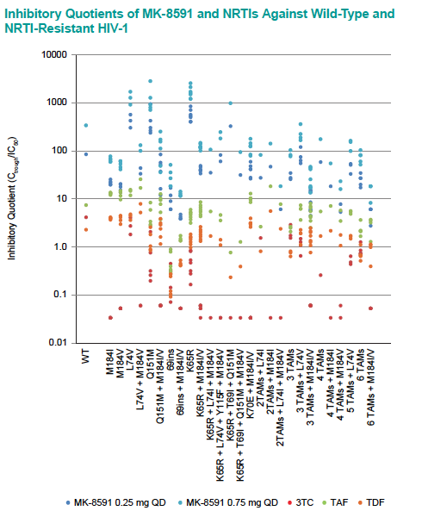
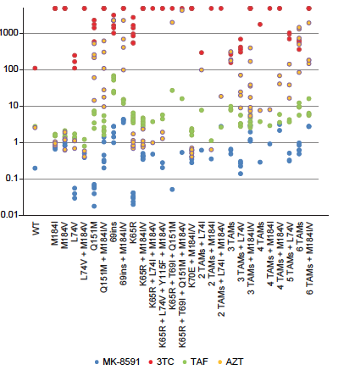

Slide 32
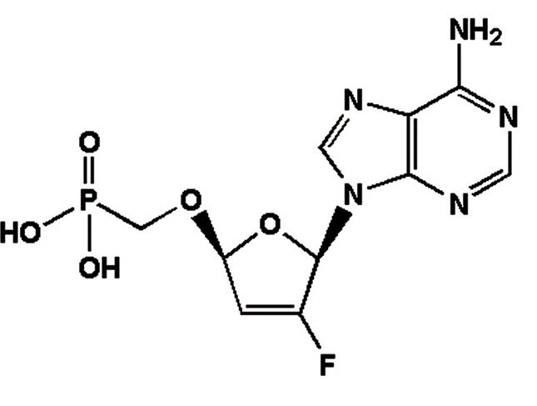
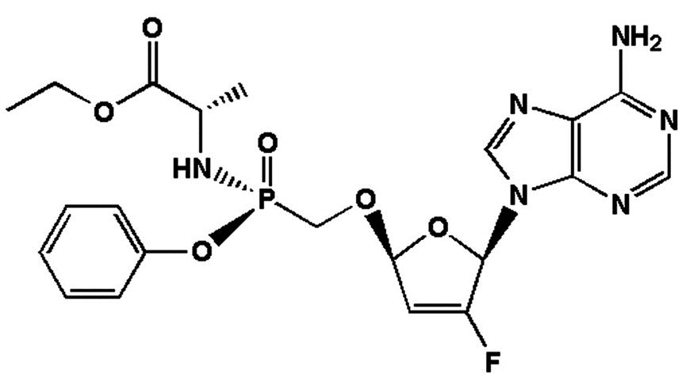
GS-9131
Broad range of activity against HIV-1 subtypes
Pro-drug of the GS-9148 with low potential for mitochondrial and renal toxicity
Maintains in vitro activity against HIV-1 viruses harboring most major NRTI resistance mutational pathways
GS-9131
GS-9148
GS-9148-Diphosphate
lnhibits HIV reverse
transcription by
chain termination
EC50=0.29-48 nM in PBMCs
EC50=10 μM in MT-2 cells
Illanca-Ibanescu R. CROI 2019, Abs. 482

Slide 33
GS-6207, novel HIV-1 capside inhibitor
Well suited for extended-release parenteral formulation
Phase 1, 40 healthy volunteers, single dose SC escalation cohorts (8 active – 2 placebo): 30 mg, 100 mg, 150 mg, 450 mg
T_{max}: 21 to 35 days
Terminal half-life: 30 to 38 days
Measurable concentrations for at least 16 weeks
Increase in exposure dose proportional
Good tolerability and safety
Sustained delivery supports dosing interval of at least 3 months
Sager JE, Abs. 141

Slide 34
GSK2838232, novel maturation inhibitor
Co-administered with cobicistat 150 mg
Phase IIa, 33 HIV infected patients: 4 QD doses x 10 days tested (20 mg, 50 mg, 100 mg, 200 mg)
Results
Steady state D8
T_{1/2} 16-19h
Mean reduction in HIV RNA dose-dependent (-1.70 Log₁₀ c/ml at D11 with higher dose of 200 mg)
Emergence of signature resistance in 2/28 patients tested
Favorable safety
DeJesus E, Abs. 142

Slide 35
PGT121, monoclonal antibody
PGT121: recombinant human IgG1 mAb targetting a V3 glycan-dependent epitope region of HIV Env.
Potent neutralizing antibody in vitro and on SHIV in monkeys
Phase 1
20 HIV- and 15 HIV+ on ART: PK of various single doses sc or iv.
Second part : 1 iv injection of 30 mg/kg in 11 HIV+ not on ART
Results
Safe, well tolerated
T_{1/2} 22 days
9 HIV + patients with ”high VL” (3.3 to 5 log10 c/ml) : 5 responders (median drop in VL of 1.7 log₁₀ c/ml by D10) and 4 non responders
In the 5 responders, rebound by D28 with emergence of resistance
2 HIV+ patients with low “viral load” (2.2 and 2.6 log₁₀ c/ml) : virologic suppression, with 1 rebound at D140 (no resistance), 1 sustained up to D168
Stephenson KE, Abs. 145LB

Slide 36
GS-9722
1st-in-class, effector-enhanced bNAb for the targeted elimination of HIV-infected cells currently in Phase 1
Engineered variant of the human antibody PGT121, with
Similar neutralization breadth
Enhanced effector function
Optimized PK
Less immunogenicity risk
And improved drug-like properties
Future studies: GS-9722 in combination with
Other effector-enhanced bNAbs
Immune-modulatory agents
Latency reversal agents
Therapeutic vaccines
Thomsen N, Abs. 356

Slide 37
Cure
research
Cure or
Remission after HSCT
ARV
strategies

Slide 38
Pembrolizumab, anti-PD1
29 HIV patients on ART with tumors
Phase 1 : Penbrolizumab 200 mg iv every 3 weeks
HIV RNA after Pembrolizumab
HIV DNA and usRNA/DNA after Pembrolizumab
Unspliced Intracellular HIV RNA
Plasma HIV RNA
Intracellular HIV DNA
Intracellular unspliced RNA/DNA
2,5
5,0
2,5
2,5
p = 0,008
p = 0,11
p = 0,004
2,0
4,0
2,0
2,0
1,5
3,0
1,5
1,5
Fold-change from Baseline
Fold-change from Baseline
Fold-change from Baseline
Fold-change from Baseline
1,0
2,0
1,0
1,0
0,5
1,0
0,5
p = 0,02
0,5
Pembrolizumab
Pembrolizumab
Pembrolizumab
Pembrolizumab
0
0,0
0
0
1
8
15
22
1
8
15
22
1
8
15
22
1
8
15
22
Days
Days
Days
Days
Transient increase in HIV transcription in CD4+ T-cells in vivo in individuals on ART consistent with latency reversal
No increase in plasma HIV RNA after administration of 2 doses
Uldrick TS, CROI 2019, Abs. 27

Slide 39
18 months HIV remission after homozygous CCR5 delta 32 allogenic HSCT
HIV male diagnosed 2003, Hodgkin 2013 : F/TDF/EFV then F/TDF + RAL (ABVD chemo)
May 2016 : Allo-HSCT (unrelated 9/10 HLA high-resolution match), donor homozygous CCR5 D 32 mutation
PET CT: lymphoma remission Dec 2017
18 months off CART (Feb 2019)
Allo-HSCT (May 2016)
STOP cART (Sept 2017)
100 % Chimerism
Mild gut GvHD
Stop Csa
TDF+FTC +RAL
RPV + 3TC + DTG
10 000
600
1 000
400
VL (copies/ml plasma)
CD4 count (cells/µL)
100
200
<1,3
<0,9
<0,8
<0,8
10
0
-215
-141
-27
+29
+77
+150
+424
+510
+1028
0
Time post HSCT (d)
Gupta RK, CROI 2019, Abs. 29LB

Slide 40
18 months HIV remission after homozygous CCR5 delta 32 allogenic HSCT
Cellular HIV-1 DNA Reservoir Measurements
10 000
100
1 000
HIV-DNA (copies/10⁶ cells)
50
100
Chimerism (% donor cells)
10
1
0
-215
-141
-27
+29
+77
+150
+424
+510
+1028
0
qPCR <0.65 LTR copies/million CD4 cells
qPCR <0.69 Gag copies/million CD4 cells
ddPCR LTR: 7/8 negative and 1 low level pos
Hematological treatment
LACE
Time after allo-HSCT (Days)
αCD52
MTX
Bosman, Nijhuis et al JIAS 2018
CsA
IUPM<0.286
IUPM<0.309
IUPM<0.063
Adaptive immune responses declining or absent post transplant
Loss of antibody responses to HIV-1
Loss of HIV-1 specific T cell responses
Gupta RK, CROI 2019, Abs. 29LB

Slide 41
HIV Cure Research : Summary
Latent reservoir
Remains enigmatic
lmproved understanding of measurement, clonal expansion, timing
Reservoir reduction
Substantial, but incomplete reductions provide valuable lessons
Early ART a priority in infants and adults
Likely need enhanced immunity to maintain durable suppression
lmmunotherapy
Many new promising strategies
Safety needs to be addressed first
Combination strategies hold promise

Slide 42
Immunotherapy strategies
Toll-like receptors
IL-15
IFN-alpha
Therapeutic vaccines
CAR T-cells
Phase 1 clinical trials of single and combination therapies
20 weeks of PEG-IFN a-2b : significant  of inducible CD4-associated HIV in ART suppressed individuals : rationale for use of PEG-IFN immunotherapy as componenet of cure-directed strategies Azzoni L, Abs. 136
Delayed viral rebound during ATI after infusion of CCR ZFN (Zinc Finger Nuclease)-transfected CD4 T cells Tebas P, Abs. 25
DUOCAR : HIV-1 based lentiviral vectors encoding chimeric antigen receptors (CAR) targeting multiple highly conserved sites on HIV-1 Env using a 2-molecule CAR architecture.
DUOCAR-T Cells potentially eliminate broad neurtalizing antibodies resistant to HIV in vivo (humanized intrasplenic model) Anthony-Gonda K. Abs. 359

Slide 43
BnAb Advances
Enhanced breadth: Trispecific bnAb starting clinical trials
Enhanced effector function
Clinical trials (ongoing or in development)
2 long-acting bnAbs (PGT121, GS-9722)
ln chronic & acute HIV+ adults, infants, adolescents
Combination: bnAbs + LRA or immunomodulators
TLR7/9 (GS-9620); HDACi; IL-15 SuperAg; therapeutic vaccines, etc.
Trispecific HIV antibodies demonstrate potent neutralization and ADCC in vitro, and mediate antiviral activity in vivo Pegu A. Abstract 28LB

Slide 45
Next ARV-Trials.com webinars:
IAS, Mexico
EACS, Basel
25th July 2019
9th November 2019

